Slide 1
Profiles for ISA-95
Gavan Hood
Paul Beesley
Dallas, 2nd February 2016

Slide 2
Profiles for ISA-95
Why ?
Greater adoption
Co-existence
Consistent doco
Work to date
Profile template
Worked industry example (CAT/ RPM)
What’s next ?
ISA-95 feedback
Profile Definition
Profile Template
Profile Example
Mining Profile
Manufacturer’s
Vendor’s
Industry Analysts
ISA
++ ??
Notes:
Should be brief presentation of 20-30 minutes to cover 3 main areas:
Why do we need profiles ?
Work we have done so far using real example to ensure structure of document is complete
What work is still to be done, building the first industry profile for Mining

Slide 3
Why Profiles ?
Industry want systems to integrate across the value chain
Improve productivity
Better visibility and control of process
Reduce cost of implementation and upgrades
Interfaces are significant part of costs
Vendors want and need prescriptive, clearly defined specifications at the message specification level of detail
Many instances of ‘standards’ do not exist
Notes:
There are many excellent software solutions and control systems that assist industries in the manufacturing process from optimising the products derived from a role of paper or fully automated engine assembly to scheduling inventory. What industry needs is systems that talk to one another.
Talk about BHPB having many industry leading solutions in place but these not integrating and issues that caused. There leadership is driving innovation into the mining industry.
We are approaching this from a slightly different angle, as a software vendor. As someone who is providing solutions into to a vertical market (mining) and wants to provide innovative, enterprise level solutions to mining industry. We have often found the need to integrate with external systems and this frequently means building ‘point’ solutions. We are constantly looking in the marketplace for standards that will allow us to build products that will integrate with other applications in the enterprise. Talk about SAP Process Order integration using ABAP code SAP iBOM and GDT’s… very proprietary! Maybe draw the XERAS/ SAP integration then highlight the fact that it does not work with Oracle, Microsoft Dynamics, Pulse or other ERP solutions used in Mining. What we need is a simple clearly defined process with supporting framework to define interfaces and publish interfaces. Often a case of being first to market defines what will become the ‘standard’
So in August the idea of having ‘Profiles’ to solve this was suggested…..

Slide 4
Why Profiles ?
ISA-95 recognises need to integrate enterprise, MOM/MES and control systems
Build on this, reuse what has been done
Accelerate adoption of ISA-95
Allow various ISA-95 implementations to co-exist
Move with ‘commercial velocity’
Allow ‘standards’ to be rapidly defined, deployed, refined
Consistent documentation standard
An open platform for defining interfaces
Write once, run many
Notes:
ISA95 recognises the need for Enterprise and Manufacturing control systems to integrate and has built an excellent model for doing this and has provided a set of XML definitions in the form of B2MML to allow these to be defined. If you want to define it in a single sentence it is an open framework for defining interfaces in manufacturing environment.
We want to build on this and allow ISA-95 deployments to be documented in a consistent manner and become standards! It is impossible to build a set of specifications that will suit all industries so we are proposing that profiles could exist to define interfaces between 2 systems at any level and that they could actually be a hierarchy of documents to define a set of standards for an industry.
Would provide a standard template for documentation to be delivered. Eg Rockwell delivering new automation systems for manufacturing plant might provide systems specification at plant ‘handover’ in this format ?
Use ISA-95 as an open platform for defining interfaces and publishing interfaces….

Slide 5
Why ISA-95?
ISA-95 Standard
Core
Cross industry
Support easier adoption of standard
Better visibility across industries
Support innovation
Allows commercial experience to feedback into standards
….
ISA-95 Profile
Industry Specific
Process specific
Systems specific
Implementation Project
Organisation Specific
Systems Integration
Implementation Specific
Commercial Project
ISA 95 Industry Working Group
Notes:
Profile is an ‘instance’ of the ISA-95 standards for a specific industry or process within an industry….
Maybe use BHPB as an example of an ISA-95 deployment driving changes back into standards… perhaps this is how we see profiles being used…. Maybe draw it again with what has happened at BHPB ? Really it is the vendors involved with BHPB who want to build the profile so that the integration can be reused and become a ‘standard’ for Mining.
Our scheduling system needs to work with both CAT and Modula Mining fleet management systems….

Slide 6
What is a Mfg Profile
Mfg Profile
A description of the information exchange semantics supported within a defined Mfg Profile scope.
Mfg Profile Scope
The extents that Mfg Profile definitions cover. This may be logical groups or sections of the role based equipment hierarchy.
For example: ISA-95 Mfg Profile, ISA-88 Mfg Profile, GS1 EPCIS, My Industry group, My Vendor Group, Vendor, manufacturer, Area X, Site Y, My Enterprise
Notes:
Are we over complicating the profile by mentioning other specifications as being used to define the scope ? We just say that the profile has a ‘scope’ and that has to be clearly defined and specific….
The next slide is an example of that …..

Slide 7
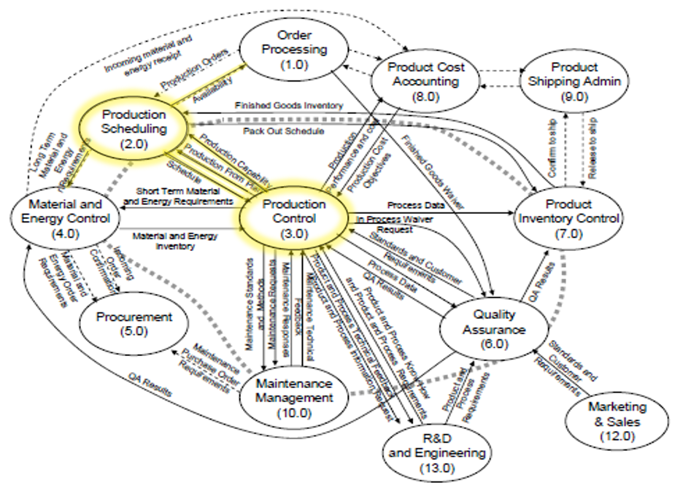
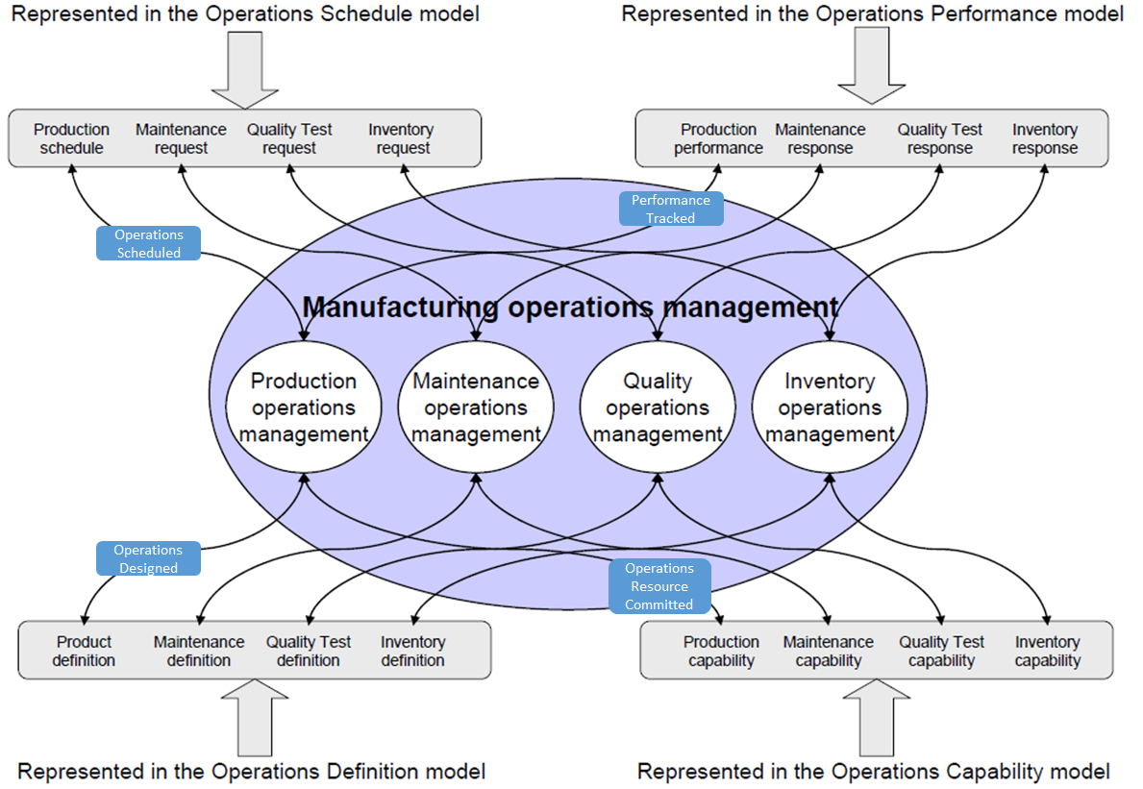
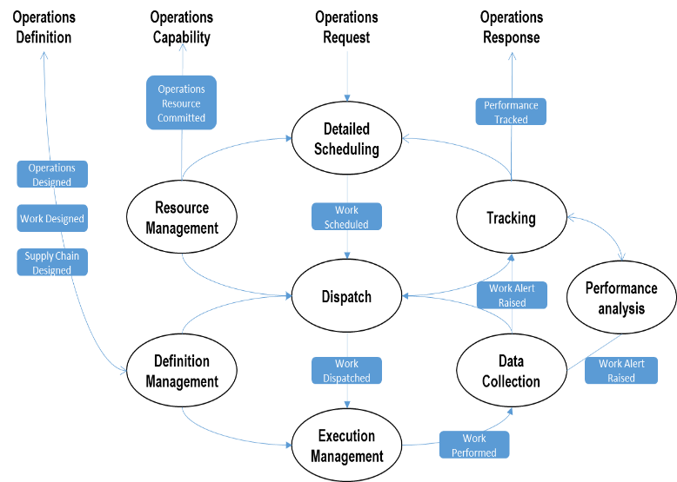
Mfg Profile Scope
Defines portions of ISA-95 represented in this profile:
Functional Model
Operational Model
Activity Model
Includes a description of each of the applications in the activity model the roles they play

Slide 8
Profiles for ISA-95
Why ?
Greater adoption
Co-existence
Consistent doco
Work to date
Profile template
Worked industry example (CAT/ RPM)
What’s next ?
ISA95 feedback
Profile Definition
Profile Template
Profile Example
Mining Profile
Manufacturer’s
Vendor’s
Industry Analysts
ISA
++ ??
Notes:
Should be brief presentation of 20-30 minutes to cover 3 main areas:
Why do we need profiles ?
Work we have done so far using real example to ensure structure of document is complete
What work is still to be done, building the first industry profile for Mining

